Slide 1
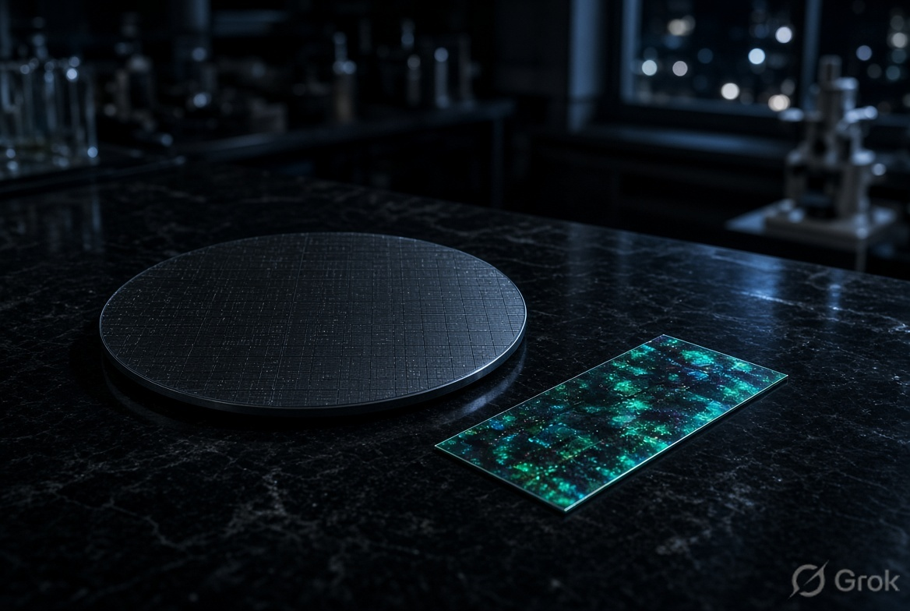
OPAL BLACK
01 / 40
VIVOVAC PTY LTD · HYDROGIEN GROUP
Opal Black
Silicon for speed. A protonic layer for long-term learning. A register an examiner has already tested.
The two machines.

Slide 2
OPAL BLACK
02 / 40
READ FIRST
Conceptual. Not an offer of securities.
Published by VivoVac Pty Ltd (ACN 652 414 376). Conceptual. Not an offer of securities. No AFSL.
Filed is not granted. Modelled is not measured. The examiner’s opinion is a written opinion, not a patent.
All IP exclusively vested in the HydroGien / VivoVac group.

Slide 3
OPAL BLACK
03 / 40
THE WORK
Nearly thirty months. One oxide chemistry. Then the register.
The programme has been running for nearly thirty months. The Australian extract starts 24 April 2025.
137 applications in this extract. 132 still live. One complete standard. Three PCT families so far.
All IP exclusively vested in the HydroGien / VivoVac group.

Slide 4
OPAL BLACK
04 / 40
IP AUSTRALIA EXTRACT
The estate, as filed.
137
132
121
Australian applications in this extract. First filing 24 April 2025.
still live. Five early provisionals lapsed; the hydrogen complete took the 24 April 2025 priority.
filed in March–April 2026. That is the engine, not a spike.
Filed is not granted. This is the work on paper.

Slide 5
OPAL BLACK
05 / 40
ISA/AU · PCT/AU2026/050399
An examiner has already written the sentence.
25 / 26
3 PCTs
2026203108
claims novel and inventive. Written opinion. Not a grant.
converted so far. This is the first family an examiner has fully searched.
Complete Australian standard. Priority 24 April 2025. Water-metal hydrogen generation.

Slide 6
OPAL BLACK
06 / 40
FILING CADENCE
The register has a rhythm.
Month | Applications in this extract
Apr 2025 | 3 — first filings. The hydrogen complete later takes this priority.
Aug–Nov 2025 | 6 — wire, Phoenix, early method.
Feb 2026 | 2
Mar 2026 | 44
Apr 2026 | 77
May 2026 | 4 — including the OPALBLACK omnibus and the intercalation architecture.
Aug 2026 | 1 — AU 2026906752, ion-intercalation-depth mode selector.

Slide 7
OPAL BLACK
07 / 40
HOW THE REGISTER READS
One chemistry. Several platforms.
Hydrogen / GALVANOXIDE
Protonic / OPALBLACK
The searched family. Fuel made where it is used. The complete and the PCTs sit here.
Compute and sensing on the same oxide. Storage stays in HOLD-05 until a counterparty funds the cell.
Coatings / PROTONGATE
Drive / Phoenix
Identity and PFAS-free routes. Authentication stays FTO-gated.
Rare-earth-free machine. Convert 20 October 2026.

Slide 8
OPAL BLACK
08 / 40
01 · THESIS
Two chips at once.
Silicon for fast maths. A protonic layer for cheap, long-term learning.
Same intelligence. Less electricity. Less water. Fewer scarce processors.
The parts exist in other laboratories. The combined system has not been measured on our film.

Slide 9
OPAL BLACK
09 / 40
02 · THE LOAD
AI is growing faster than the machines we put it on.
Millions
945 TWh
9.3 tn L
of AI processors. Factory, packaging, and special memory must line up.
IEA base case for data-centre electricity by 2030. About Japan’s whole grid.
UN figure for water tied to that electricity. Most of it is used making the power.
Sources: IEA; UNU-INWEH 2026. Not Opal Black measurements.

Slide 10
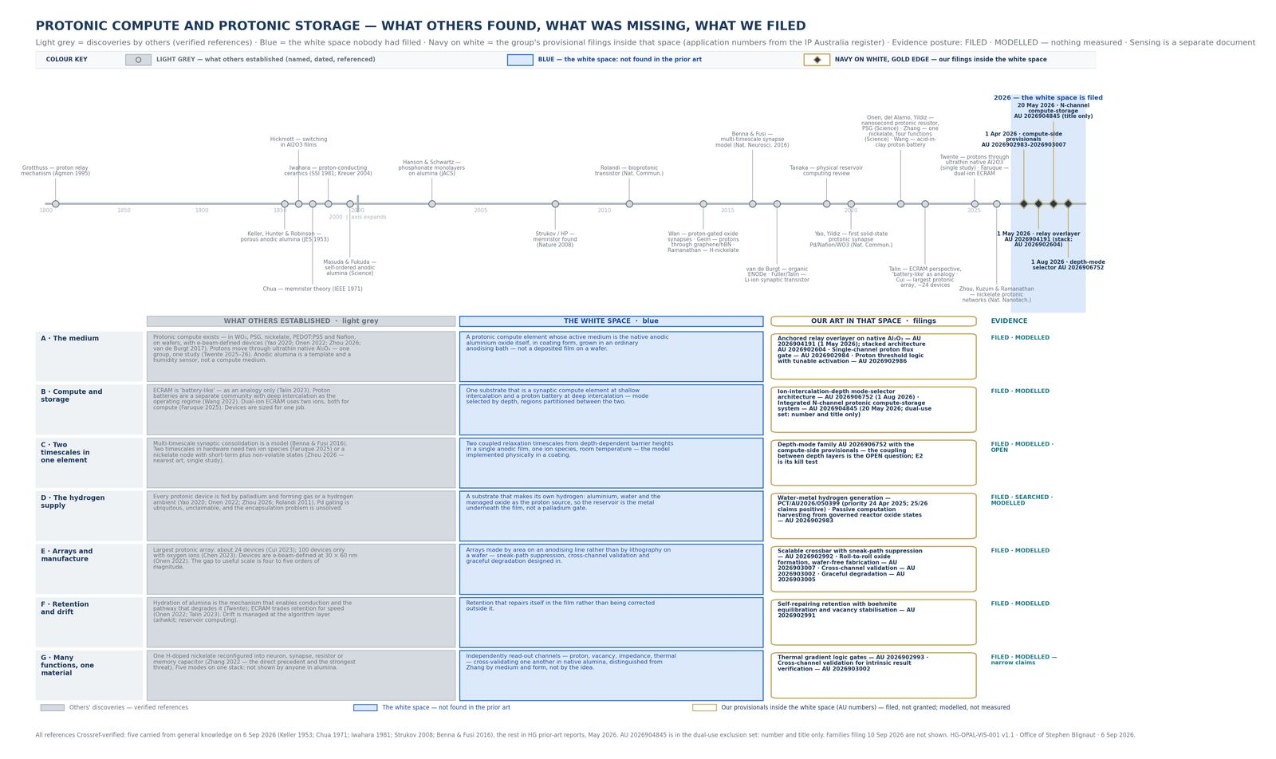
OPAL BLACK
10 / 40
03 · WHAT STAYS
We do not replace silicon.
We stop asking it to do the slow job. Fast digital work stays on the chip the world already knows how to buy.
Physics on the oxide. Nerves on silicon.

Slide 11
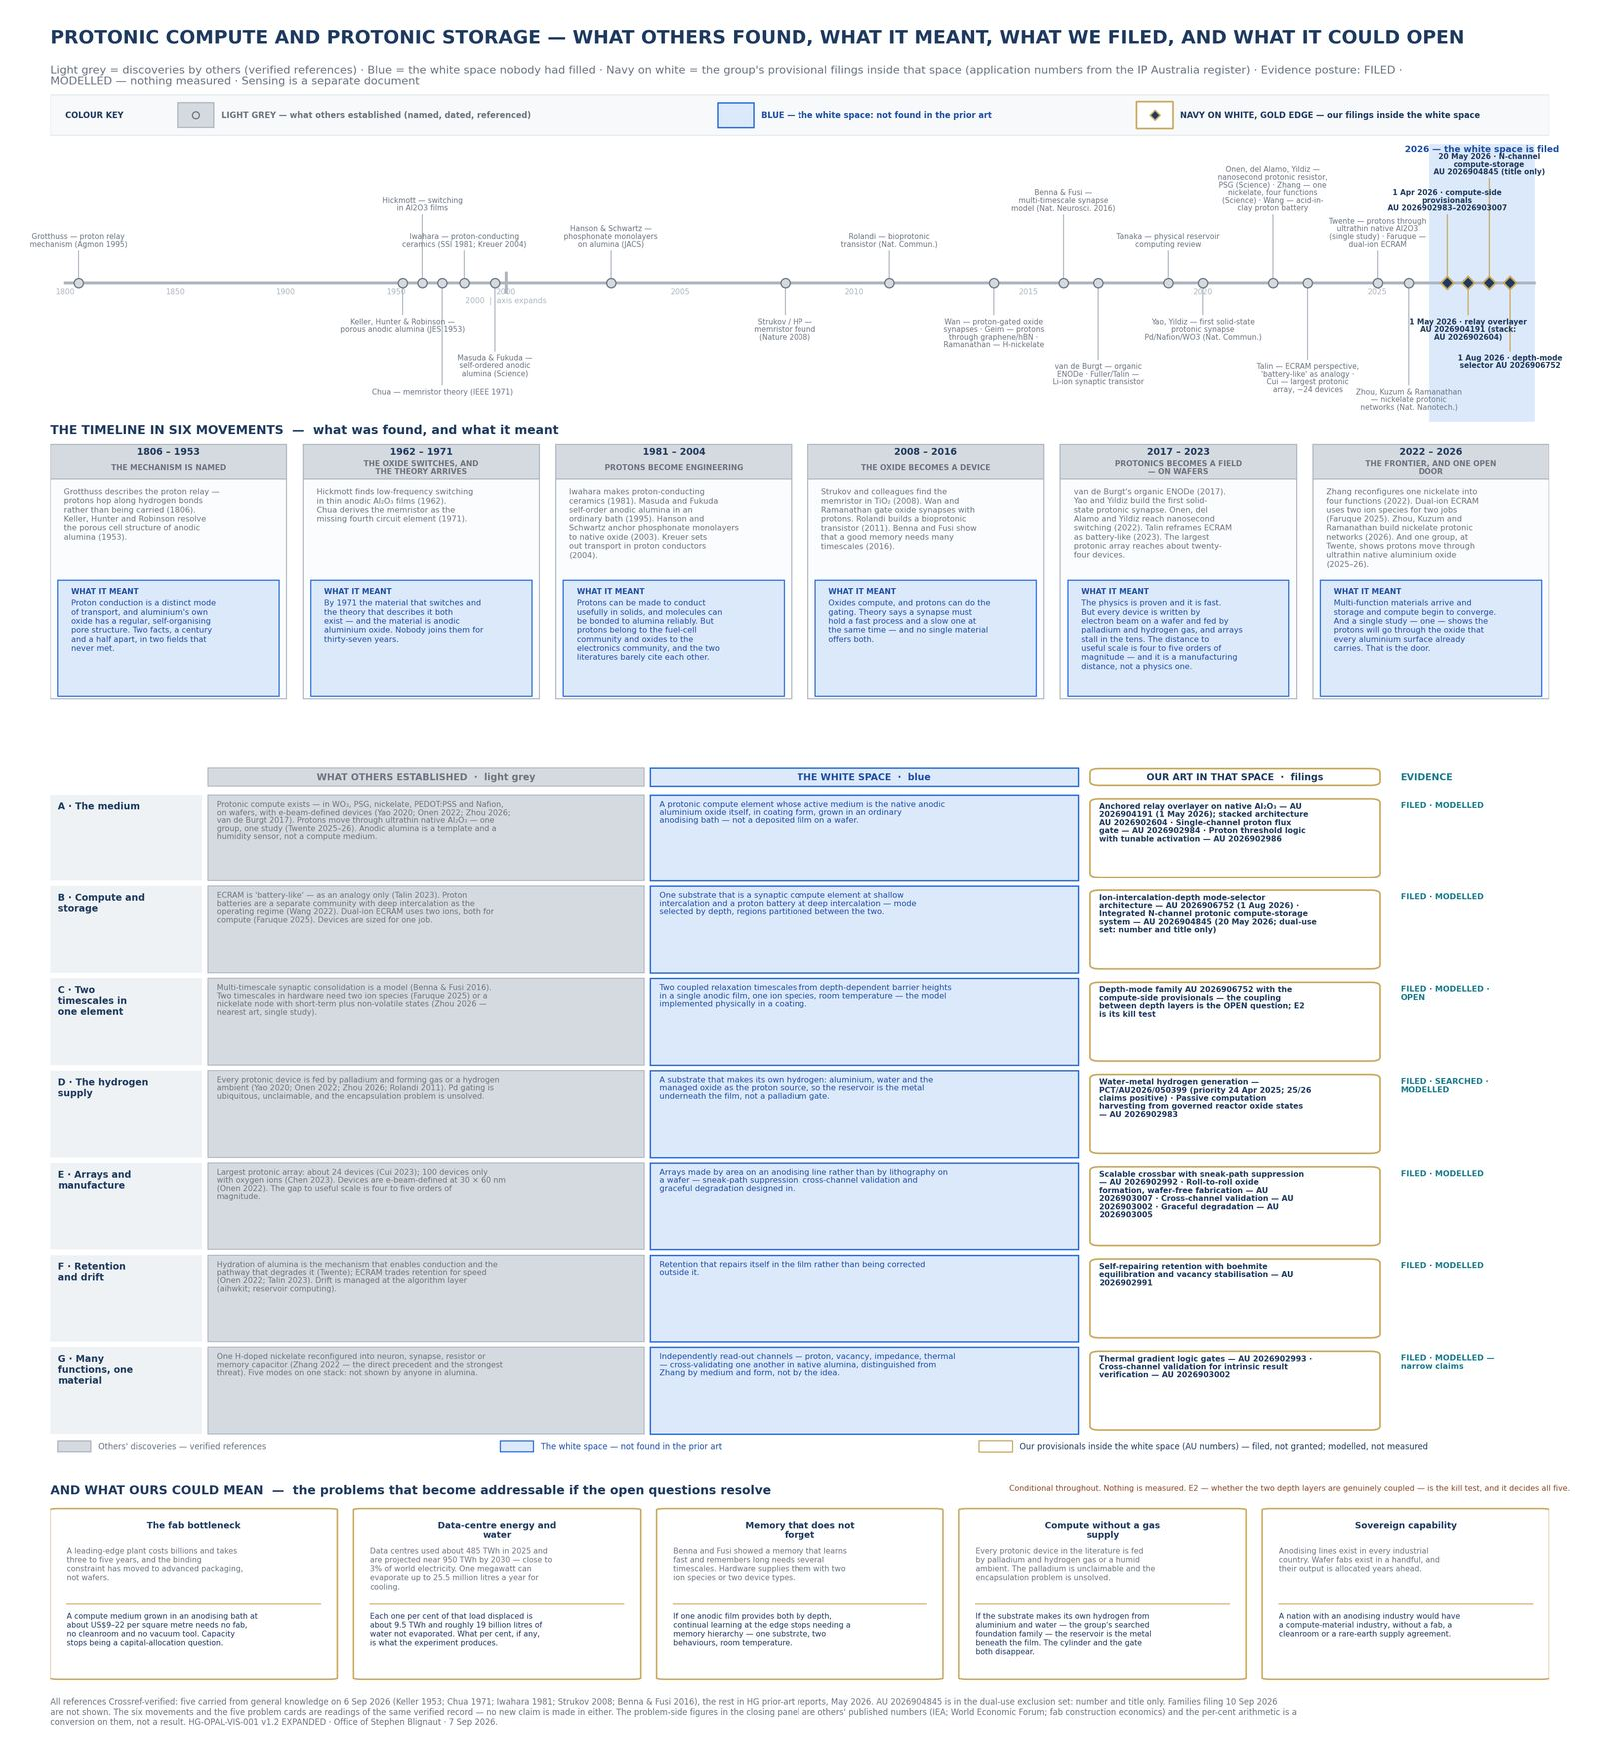
OPAL BLACK
11 / 40
04 · THE SECOND LAYER
Memory and processing in the same thin oxide.
Grown from aluminium and water on an ordinary anodising line — not a ten-to-twenty-billion-dollar fab.
Onen et al., Science 2022, showed protonic analogue weights next to CMOS. Their device. Not our film.
Compute and storage live here. Not on the sensing plate.

Slide 12
OPAL BLACK
12 / 40
05 · ALREADY REAL
The pieces exist. The system does not, yet.
Already shown
Our job
Anodising is industrial. Protons move in that oxide at room temperature. MIT showed protonic analogue weights next to silicon in 2022.
Put those pieces in one system. That combined system is Opal Black. IN-DEVELOPMENT.

Slide 13
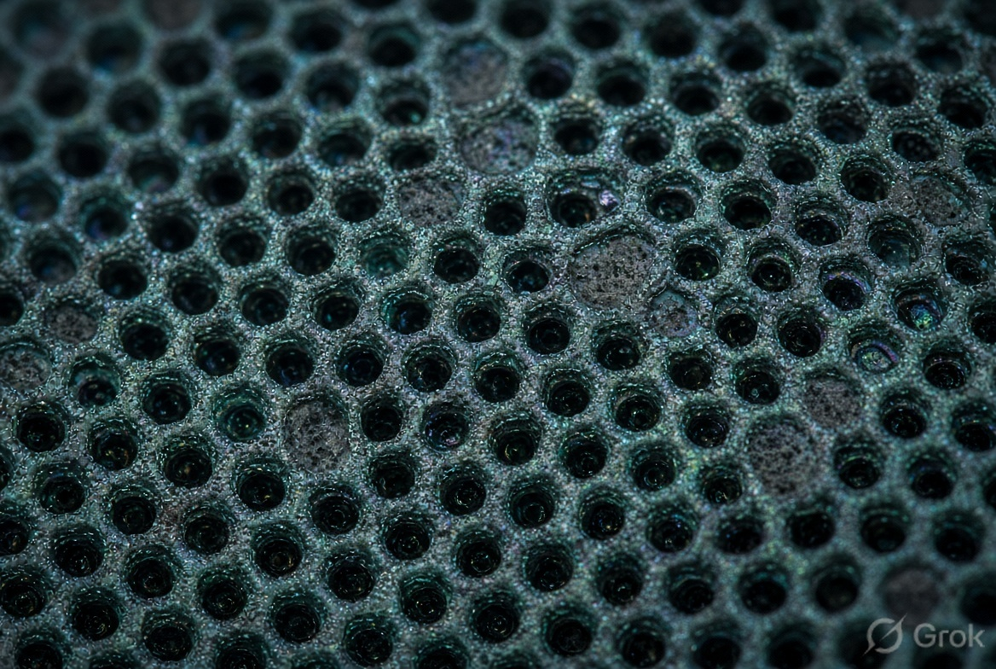
OPAL BLACK
13 / 40
06 · MATERIAL
Ordinary anodising. No vacuum. No fab.
Porous anodic alumina, 5–25 µm, on ordinary aluminium. Moisture and ions move in the pores. We read electrically. We do not claim a lifetime, a self-heal, a display, or a stored bit that has been measured.
The material, not a product shot.

Slide 14
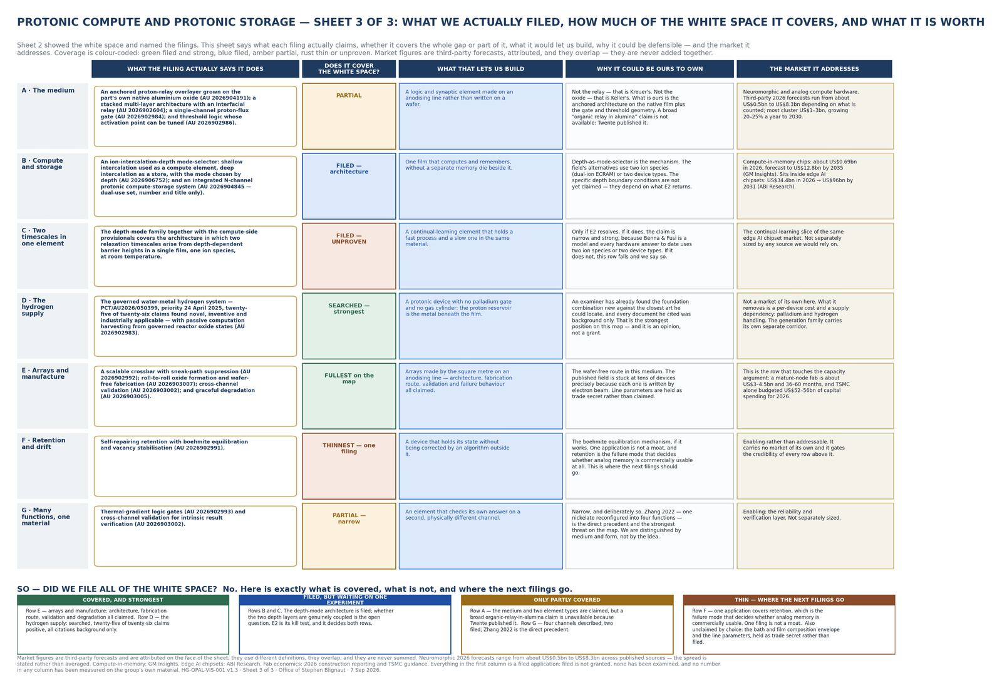
OPAL BLACK
14 / 40
08 · HYBRID DOCTRINE
Protons as physics. Silicon as nerves.
Ion Torrent CMOS is the solved fab problem for a proton-to-silicon seam.
When readers get faster, the film gets more valuable, not less. We are not in the data-centre chip race.
Readout, classification, silicon seam.

Slide 15
OPAL BLACK
15 / 40
VS. CHIPS
That chip makes the data centre faster. We are not in the data centre.
 | Silicon | Photonic | Protonic
Job | Fast digital maths | Fast interconnect | Slow, cheap, long-term learning
Fab | Leading-edge wafer | Photonic line | Anodising line
Environment | Dry, cooled racks | Packaged, aligned | Open film. Room temperature.
Location | Data centre | Data centre | Beside the chip, or on a surface
Posture | Kept | A faster reader helps us | IN-DEVELOPMENT. Not measured here.

Slide 16
OPAL BLACK
16 / 40
EVIDENCE
A tag on every claim.
ESTABLISHED
FILED
SEARCHED
Other people’s published work.
On the register. Not granted.
An examiner’s written opinion.
MODELLED
IN-DEVELOPMENT
OPEN
Computed. Not measured.
Intended. Not built.
No document found. Not a grant.

Slide 17
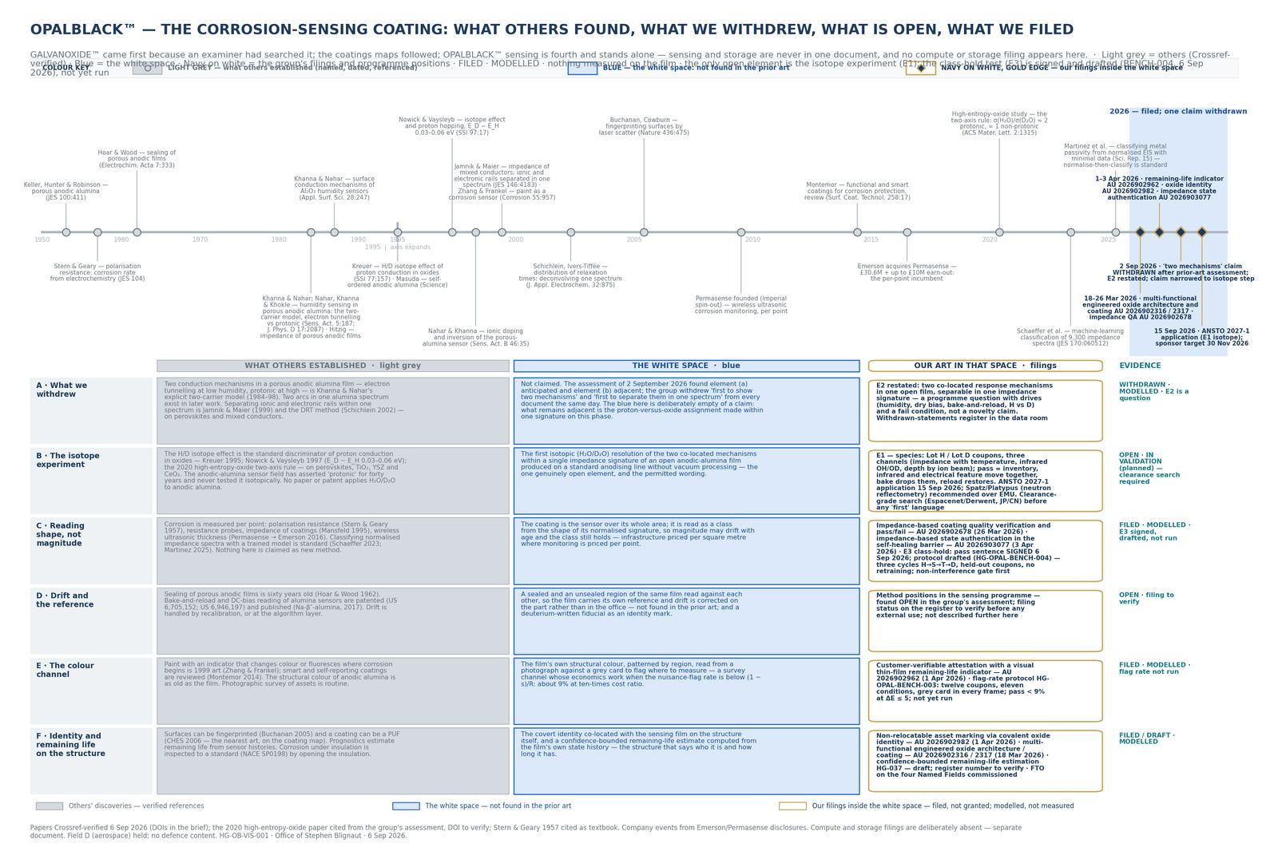
OPAL BLACK
17 / 40
SENSING · VIVOVAC
A coating that reports. Not a probe.
Open anodic film. Moisture and salt move protons. We read impedance shape.
If a customer needs a number stored for a year, we cannot help and say so before they ask.
Storage is never on this plate.

Slide 18
OPAL BLACK
18 / 40
07 · THE FENCE
Most of the sentence is anticipated. One element is open.
Element | Closest art | Status
(a) Two mechanisms in porous AAO | Khanna & Nahar 1984–1998 | ANTICIPATED
(b) Separation in one spectrum | Jamnik & Maier 1999; DRT — not AAO | ADJACENT
(c) H/D on anodic alumina | None on AAO. Method: Nowick 1997 | OPEN
(d) Bake/reload + DC bias | US 6,705,152; US 6,946,197 | ANTICIPATED / ADJACENT
(e) Classifier on normalised EIS | Schaeffer et al. JES 2023 | ANTICIPATED
(f) Full stack, open film, no vacuum | No single document | OPEN combination

Slide 19
OPAL BLACK
19 / 40
THE ONLY PERMITTED ‘FIRST’
First isotopic resolution on this film. After data. That sentence only.
Permitted: first isotopic (H₂O/D₂O) resolution of two co-located mechanisms within one impedance signature of an open anodic-alumina film on an anodising-line substrate.
Not permitted: first two-state coating. First to separate two mechanisms. First to classify EIS with ML. Nobody has attempted this.

Slide 20
OPAL BLACK
20 / 40
LAB
Four experiments. None run.
E1 Species
E2 Two mechanisms
Lot H / Lot D. EIS, infrared, depth. Pass: they move together. Fail: we may not say hydrogen.
Restated. Nothing is stored. Pass: one relaxation ≈ 1 and one ≈ 1.4–2.
E3 Class-hold
E4 Flag-rate
Cannot be drafted until the pass sentence is signed. Shape, not ohms.
12 coupons. Pass: nuisance flag < 9% at R = 10.

Slide 21
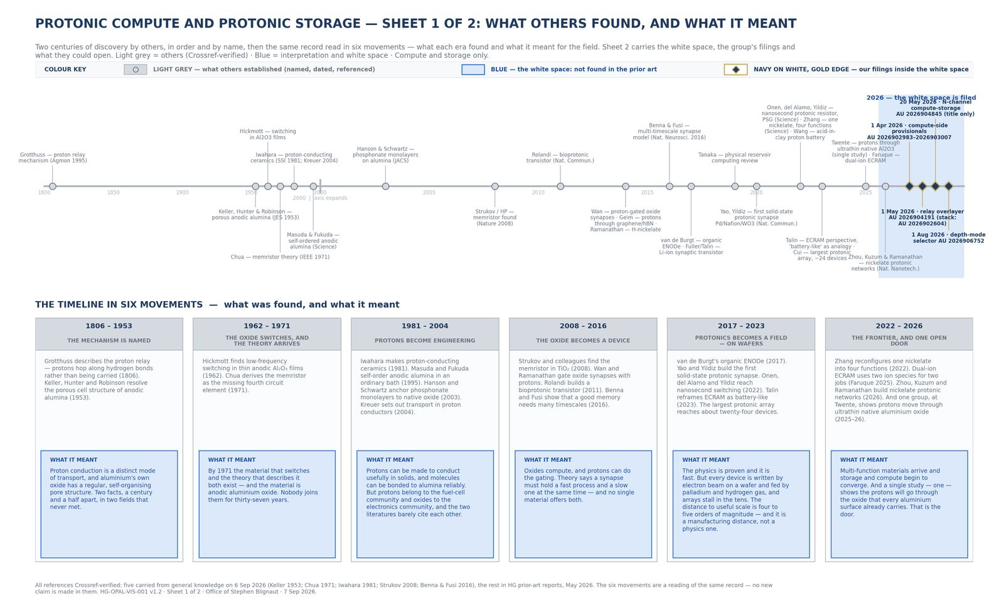
OPAL BLACK
21 / 40
READOUT
Read shape, not size.
Per-spectrum normalisation. Half-fall frequency, phase peak, characteristic time constant. Raw |Z| does not survive ageing.
Sweep 100 Hz–100 kHz. Sub-100 Hz is physically unreliable on a responsive film.
What others found, in time order.

Slide 22
OPAL BLACK
22 / 40
FOUNDATION PLACES · NOT A SECURITY
Industry funds the experiments for first look, not equity.
Observer · A$250k
Programme Partner · A$650k
Founding Partner · A$1.2m
Sight. No field lock.
First look + non-exclusive field option.
Exclusive option in one Named Field.

Slide 23
OPAL BLACK
23 / 40
NAMED FIELDS
Anodisers first. Not Woodside first.
A · Onshore process
B · Marine / offshore
CUI beachhead. Not Place 1 at a major.
Aluminium hull. Class-society JIP wrapper.
C · Architectural envelope
D · Aerospace structure
The anodiser already runs the bath. Fastest coupon.
Lighthouse. Never Place 1.

Slide 24
OPAL BLACK
24 / 40
FIRST FIVE
People who already run the bath or sell the inspection.
1. Universal Anodisers or DECO Industrial.
2. ALS integrity or IRISNDT technical.
3. Austal or Incat materials.
4. One mid-tier process innovation lead already warm from the hydrogen map.
5. One class-society coatings manager, information only.
Do not call first: BHP, Rio Tinto, Fortescue, Woodside, Santos, Emerson/Permasense, CorrosionRADAR, Boeing, Airbus.

Slide 25
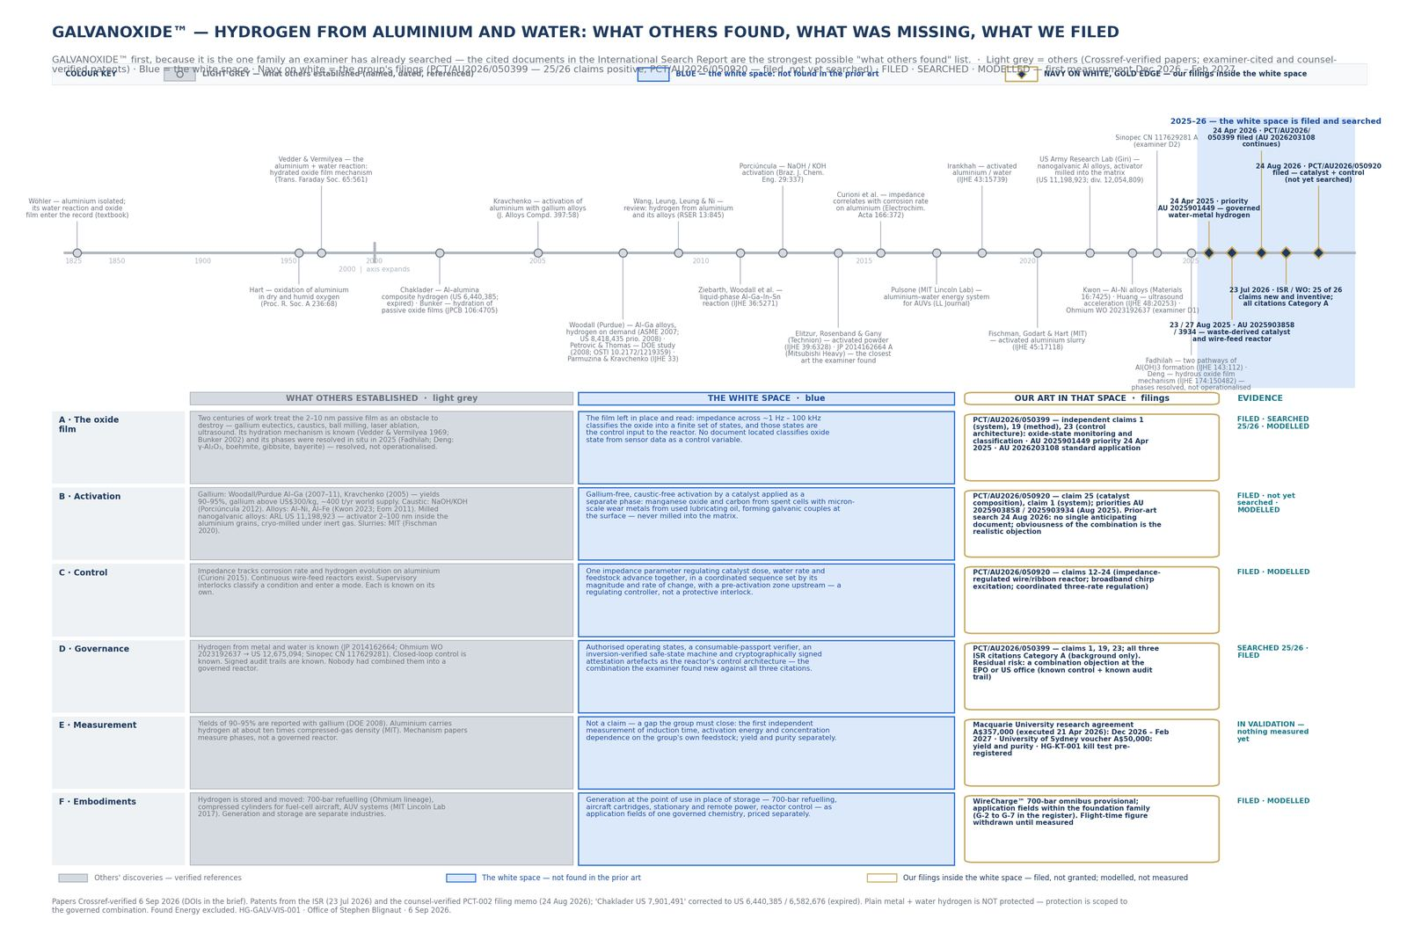
OPAL BLACK
25 / 40
GALVANOXIDE · SEARCHED · THREE PCTS
Twenty-five of twenty-six. The examiner agreed.
ISA/AU on PCT/AU2026/050399: 25 of 26 claims novel and inventive. That is a written opinion. It is the best independent test the family has had.
Three PCT families converted so far. One complete Australian standard — 2026203108 — takes priority from 24 April 2025. Storage tests do not travel with the sensing pitch.
What others found. What the examiner wrote.

Slide 26
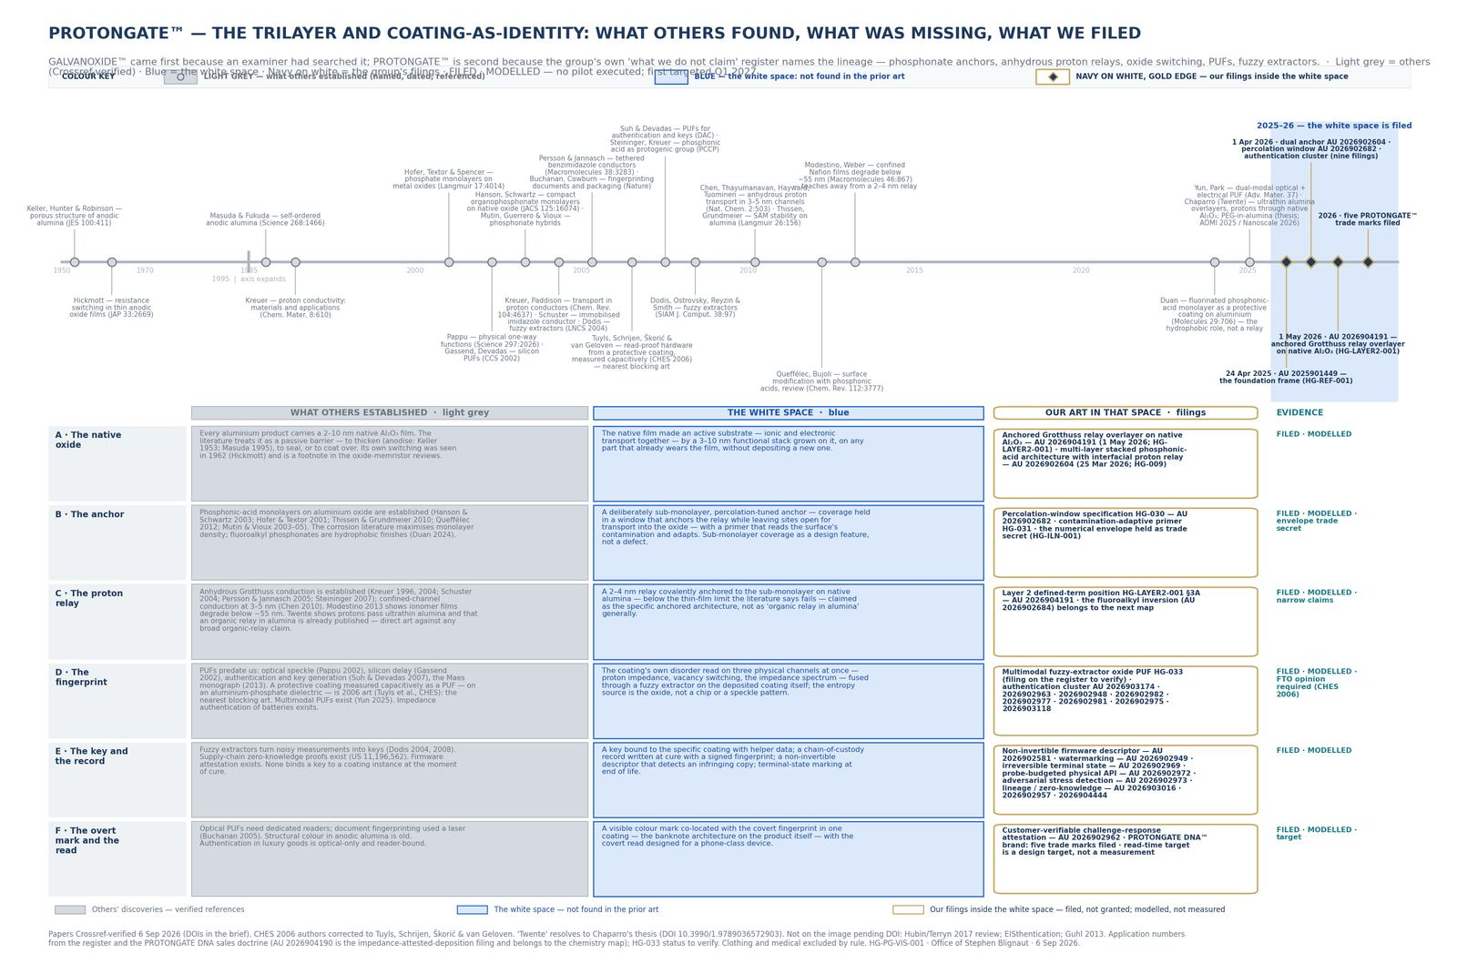
OPAL BLACK
26 / 40
PROTONGATE DNA · FTO-GATED
The coating is the fingerprint.
PFAS-free routes. Authentication gated on CHES 2006. Identity, marine, applicator licence.
No external PUF sentence until FTO is done.
Coating map.

Slide 27
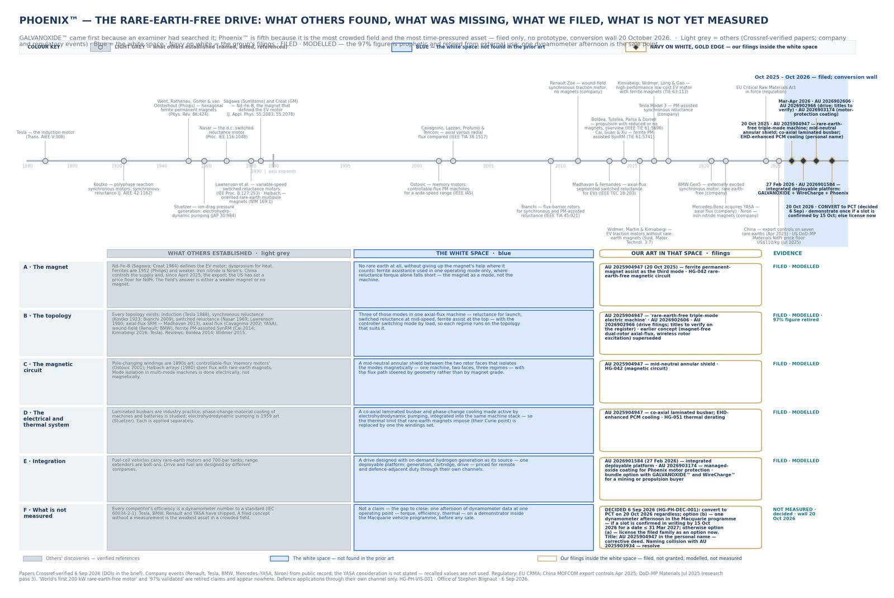
OPAL BLACK
27 / 40
PHOENIX · CONVERT 20 OCT 2026
Rare-earth-free drive. Convert or sell as filed.
Actuator cores stay off this deck until 17 September 2026. Prior art is in full. Invention cores are withheld.
Phoenix Motor / AITHERIA.

Slide 28
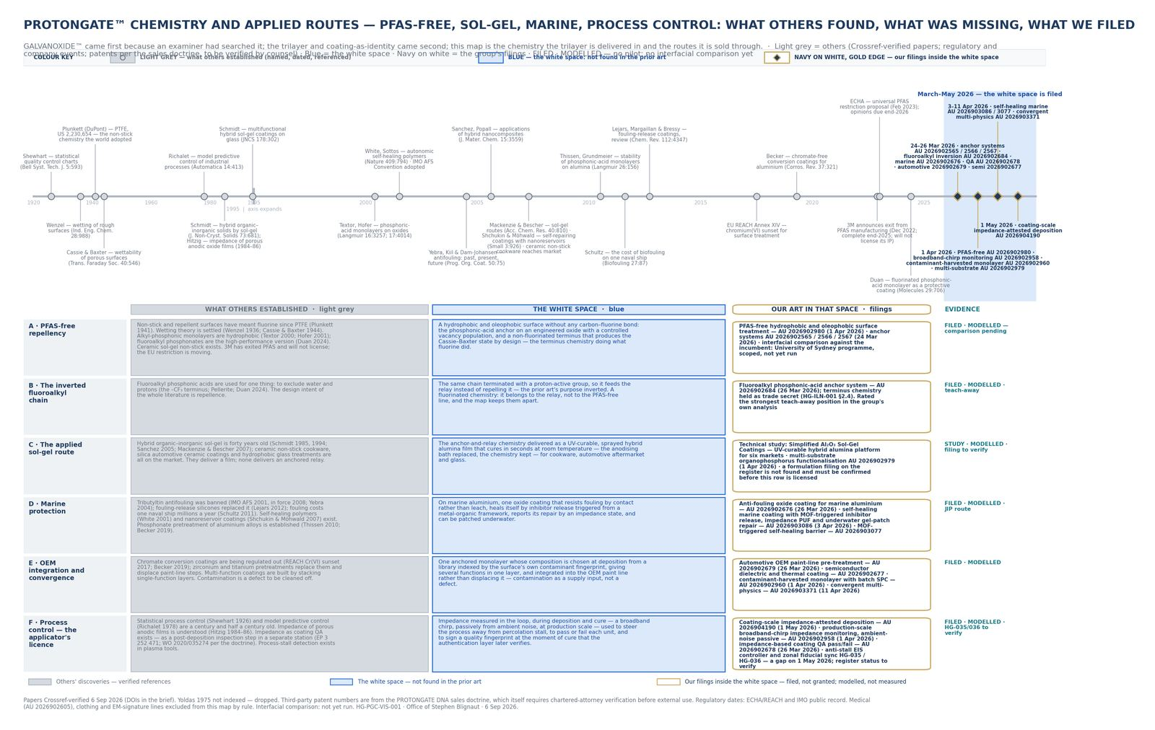
OPAL BLACK
28 / 40
09 · SHARED OXIDE
They share an oxide. They do not share a product.
Opal Black is the compute reading. It is not the hydrogen reading and it is not the coatings-as-identity reading.
Shared chemistry. Separate claims. Separate rooms.

Slide 29
OPAL BLACK
29 / 40
ENTITY MAP
The note and the sponsorship are different things.
Entity | ACN | Holds
HydroGien Group Limited | 697 565 610 | Note issuer. Capital-raise vehicle.
HydroGien Pty Ltd | 689 125 871 | Operating / IP.
VivoVac Pty Ltd | 652 414 376 | OPALBLACK. GALVANOXIDE chemistry. Places.
GreyCorp AI Pty Ltd | — | OPALBLACK brand. OzBrite LLM.
8Invent Pty Ltd | — | The method. Not sold.
PROTONGATE DNA Pty Ltd | — | Coatings holdco. Background IP.
Regen Factor Pty Ltd | — | Medical. Out of scope.

Slide 30
OPAL BLACK
30 / 40
CONVERTIBLE NOTE · NOT AN OFFER
Twelve million, before the data.
Term
Size | US$1 million
Cap | US$12M post-money on first US$500k; US$15M on balance
Step-up | US accredited at 506(c) minimum, or executed sponsorship
Discount / coupon / maturity | 20% / 8% simple / 24 months
Qualified financing | ≥ US$2 million
Law | NSW
US | Reg D 506(c); Form D in 15 days; flip covenant
AU | s708(8); s708(1) 20 / A$2M; no hawking

Slide 31
OPAL BLACK
31 / 40
COMMERCIAL TENSION
Build-to-sell and licence-first are both live.
Build-to-sell
Licence-first
Filed + searched + one independent measurement. The seller pays for the cheap evidence. The buyer takes the expensive evidence. 8Invent is not sold.
Field-of-use options on Named Fields. GALVANOXIDE is the exception the sell-plan names as a sale.
Counsel has not closed which one the note discloses. Forcing function: ~120 provisionals convert March–April 2027.

Slide 32
OPAL BLACK
32 / 40
8INVENT · NEARLY 30 MONTHS
Invent. File. Search. Measure once. Transfer. Repeat.
Nearly thirty months of programme. Sixteen months of filings. March and April 2026 were the engine: 121 applications in two months.
1. Research, then file on the gap.
2. Let an examiner test it — one family already has.
3. Put each question to the right laboratory. Keep what it returns.
4. Let industry fund the experiments for first look, not equity.
5. License by field at first measurement, or sell the one the plan sells.
6. Repeat. The method is not sold.

Slide 33
OPAL BLACK
33 / 40
HARD DATES
The next conversions are on the calendar.
Date | Item
15 Sep 2026 | ANSTO 2027-1 merit round closes 11:59 pm AEST
17 Sep 2026 | Actuator map may be spoken
23 Sep 2026 | Article 19 window, PCT/AU2026/050399
30 Sep 2026 | AU 2025904522 — wire / consumable hydrogen — conversion wall
20 Oct 2026 | AU 2025904947 — Phoenix Motor — conversion wall
29 Oct 2026 | AU 2025905144 conversion wall
26 Nov 2026 | AU 2025905804 conversion wall
Mar–Apr 2027 | The March–April 2026 cluster comes due — 121 filings
1 Aug 2027 | AU 2026906752 OPALBLACK intercalation — PCT deadline

Slide 34
OPAL BLACK
34 / 40
WHAT DECIDES THE NEXT FOUR WEEKS
No document substitutes for these.
1 · Counsel
2 · Title
3 · E3 sentence
Reg D and M&A. Every deed, note, and Article 19 depends on it.
HG-PCT-002 corrective assignment. Gates the option-deed warranty.
The class-hold protocol cannot be written without it.
4 · Live site
5 · CHES 2006 FTO
6 · Espacenet / Derwent
Clothing, health, and pre-retraction novelty still gate outreach.
Before any external PUF sentence.
JP/CN not cleared. Before any ‘first’ goes external.

Slide 35
OPAL BLACK
35 / 40
WHITE SPACE
Two of seven survive. File chemistry. Do not build a plant.
# | Candidate | Verdict
1 | MIXE / negative-muon elemental analysis | FAIL
2 | 14 MeV neutrons / fusion materials | FAIL
3 | Li-6 / Li-7 via metal-oxide ion transport | SURVIVES
4 | Tritium permeation-barrier oxide | SURVIVES narrow
5 | Muography beyond current markets | FAIL
6 | Muon tomography + MIXE | FAIL
7 | HB11 / p-¹¹B Australian fusion | Not an IP opportunity

Slide 36
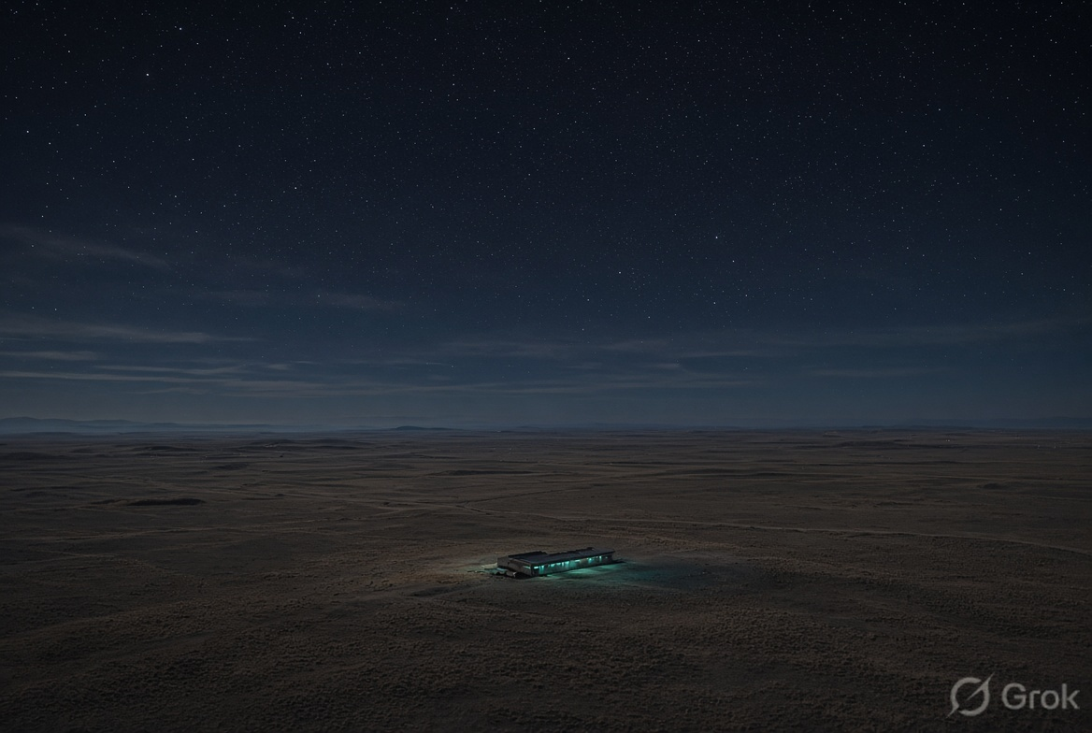
OPAL BLACK
36 / 40
11 · AUSTRALIA FIRST. WORLD OPEN.
Secure Australia’s AI. Let anyone join it.
Bauxite, aluminium, water, and anodising capacity already exist here. The company is Australian. Access is not a nationality test.
Infrastructure first. Access open.

Slide 37
OPAL BLACK
37 / 40
12 · THREE CUTS, NOT A BADGE
Fewer chips. Less electricity. Less water.
Fewer chips
Less electricity
Less water
Long-term learning leaves the GPU queue.
Intention, not a measured saving.
Most data-centre water is used making the electricity.

Slide 38
OPAL BLACK
38 / 40
13 · NOT YET MEASURED
What this is not.
Not a finished commercial AI product.
Not a measured energy or water saving.
Not a granted patent portfolio.
Not a replacement for silicon.
Not medical, clothing-on-body, space, or a TGA health claim.
Not storage on the sensing programme.
Nothing here has been measured on our film by an independent laboratory.

Slide 39
OPAL BLACK
39 / 40
14 · ACCESS
Join Opal Black from anywhere.
Leave a name. When access opens, we write. No nationality test. This is a waitlist. It is not an offer of securities.

Slide 40
OPAL BLACK
40 / 40
CLOSE
Thirty months in. The examiner has already found the gap.
VivoVac Pty Ltd · ACN 652 414 376 · Australia
Claire Ironside, Commercial Liaison · invest@hydrogien.com.au
Conceptual. Not an offer of securities. Filed is not granted.
The film. Not a result.

